Slide 1
INTEL UNNATI
Power-Manager-Telemetry
-Harini S
-URK21AI1051

Slide 2
Problem Statement
In the era of 5G and edge computing, the deployment of devices across different locations has increased, leading to a higher power consumption. To address this issue, the government is pushing enterprises and industries to reduce power usage. The goal is to achieve net-zero power consumption. Additionally, the price of electricity is increasing, making it crucial to understand the total power drawn by system.
1.Researching and identifying open-source tools for power measurement.
2.Identifying and documenting the available knobs in a system to measure power.
3.Collect power telemetry data from CPU, memory, NIC, and TDP etc.
4.Measure and record system power utilization for CPU, NIC, and TDP based on the input parameter of system utilization percentage.
Create a report on the power problem, technical approach, and results

Slide 3
Project Overview
The project focuses on addressing high CPU usage by applications and assessing the effects of applying CPU limits at 70%, 50%, and 30% thresholds.
1. Data Collection:
Initially, CPU usage data was collected under normal conditions and then under controlled CPU limits of 70%, 50%, and 30% using Python's psutil library.
2. Tools Used:
The project utilized psutil to monitor and compare CPU usage data across different CPU limit settings, enabling detailed analysis of system performance impacts.
3. Visualizations:
Visualizations were generated to illustrate overall CPU usage trends and specific impacts on the top 50 applications, providing insights into how CPU limits affect application performance.

Slide 4
Project overview
4. Analysis:
The analysis highlighted significant contributors to high CPU usage among applications and offered recommendations for optimizing system performance based on observed data under varying CPU limits.
5. Approach:
The project adopted a systematic approach, starting with problem identification, followed by data collection under different CPU limit scenarios, rigorous evaluation of performance impacts, and concluded with actionable insights for performance optimization.
This structured approach aimed to provide a comprehensive understanding of CPU usage dynamics and inform effective strategies for managing and optimizing system resources.

Slide 5
Features Offered
Data Collection:
Captures initial CPU usage data under normal operating conditions.
Collects CPU usage metrics under controlled CPU limits (70%, 50%, 30%).
Tool Utilization:
Utilizes psutil for real-time monitoring and data collection of system and process information.
Data Analysis:
Calculates average CPU usage per application.
Conducts comparative analysis to assess the impact of CPU limits on performance.

Slide 6
Features Offered
Visualization:
Presents CPU usage comparisons across applications using bar plots.
Visualizes overall system performance changes with applied CPU limits.
Insights and Recommendations:
Provides insights into application-specific CPU usage patterns.
Offers recommendations for optimizing system performance based on observed data.
Insight Generation:
Analyzes application-specific CPU usage, visualizes impacts with bar plots, and provides optimization recommendations for improved system performance.

Slide 7
Process Flow
1.Project Start
2.Problem Statement Define the issue of high CPU usage by applications.
3.Objectives Set goals: Monitor CPU usage, apply varying CPU limits (70%, 50%, 30%), and analyze their impact.
4.Data Collection
Initial Data: Gather CPU usage data for all applications under normal conditions.
Limited Data: Apply CPU limits (70%, 50%, 30%) and collect usage data.
5.Data Processing
Calculate Average CPU Usage: Compute average CPU usage for each application across different limits.
Group Data by Application: Organize data by application name for detailed analysis.

Slide 8
Process Flow
Comparative Analysis
Compare CPU Usage: Analyze and compare average CPU usage under different CPU limits.
Assess Changes: Determine CPU usage variations before and after applying limits.
Visualization
Bar Plots: Visualize CPU usage of top 50 applications under varying CPU limits.
System Performance: Present visual insights into overall system performance with imposed CPU limits.

Slide 9
Process Flow
Insights and Recommendations
Identify High Usage Applications: Identify applications with significant CPU resource consumption.
Optimization Suggestions: Provide actionable recommendations to optimize CPU usage based on analysis.
Following this structured approach systematically addresses high CPU usage, evaluates the impacts of CPU limits, and provides actionable insights to optimize system performance.

Slide 10
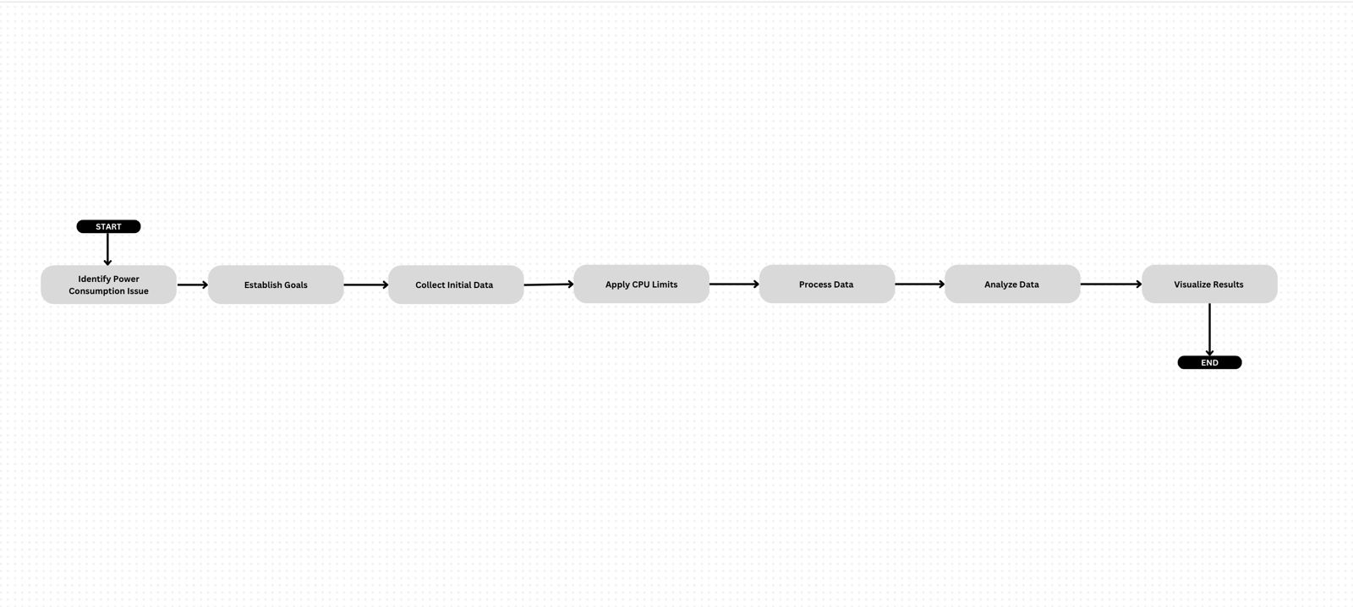
Architecture Diagram

Slide 11
Technologies Used
Python:
Primary language for scripting and execution.
Python Libraries:
psutil: Collects real-time CPU and memory data.
pandas: Processes and analyzes data.
matplotlib: Creates visualizations like bar plots and line charts.
seaborn: Enhances visualizations with statistical graphics.

Slide 12
Team members and contribution
-This project was entirely executed by myself.

Slide 13
Conclusion
This analysis successfully demonstrates the capability to monitor and analyze CPU usage at various simulated levels on a Windows system using a combination of Python tools and techniques. The project highlights how different CPU usage levels affect system performance, providing valuable insights that can guide optimization efforts.
This project offers a versatile solution for optimizing system performance across Windows, macOS, and Linux platforms. By effectively managing CPU and power usage, it enhances laptop longevity, reduces energy consumption, and ensures smooth operation even under high software demands. The user-friendly design simplifies system monitoring and control, promoting both user satisfaction and environmental sustainability through efficient resource utilization.

